Slide 1
Applying Data Warehouse Techniques

Slide 2
About Me
Tennessee Tech - Computer Science
Nashville Native
Working with SQL Server since 2010
Data Warehousing/Business Intelligence
Application Development
Twitter: @SpencerSwindell
Email: spencer.swindell@gmail.com
Blog: mytwospence.com

Slide 3

Think Data Insights
Modern Data Warehouse Design and Architecture
On-Premise SQL Server and Azure Data Platform
PowerBI Solutions and Training
Advanced Analytics and Machine Learning
Based in Nashville, TN
Microsoft Gold Partner

Slide 4
LBMC
MAKE A GOOD BUSINESS BETTER

Slide 5
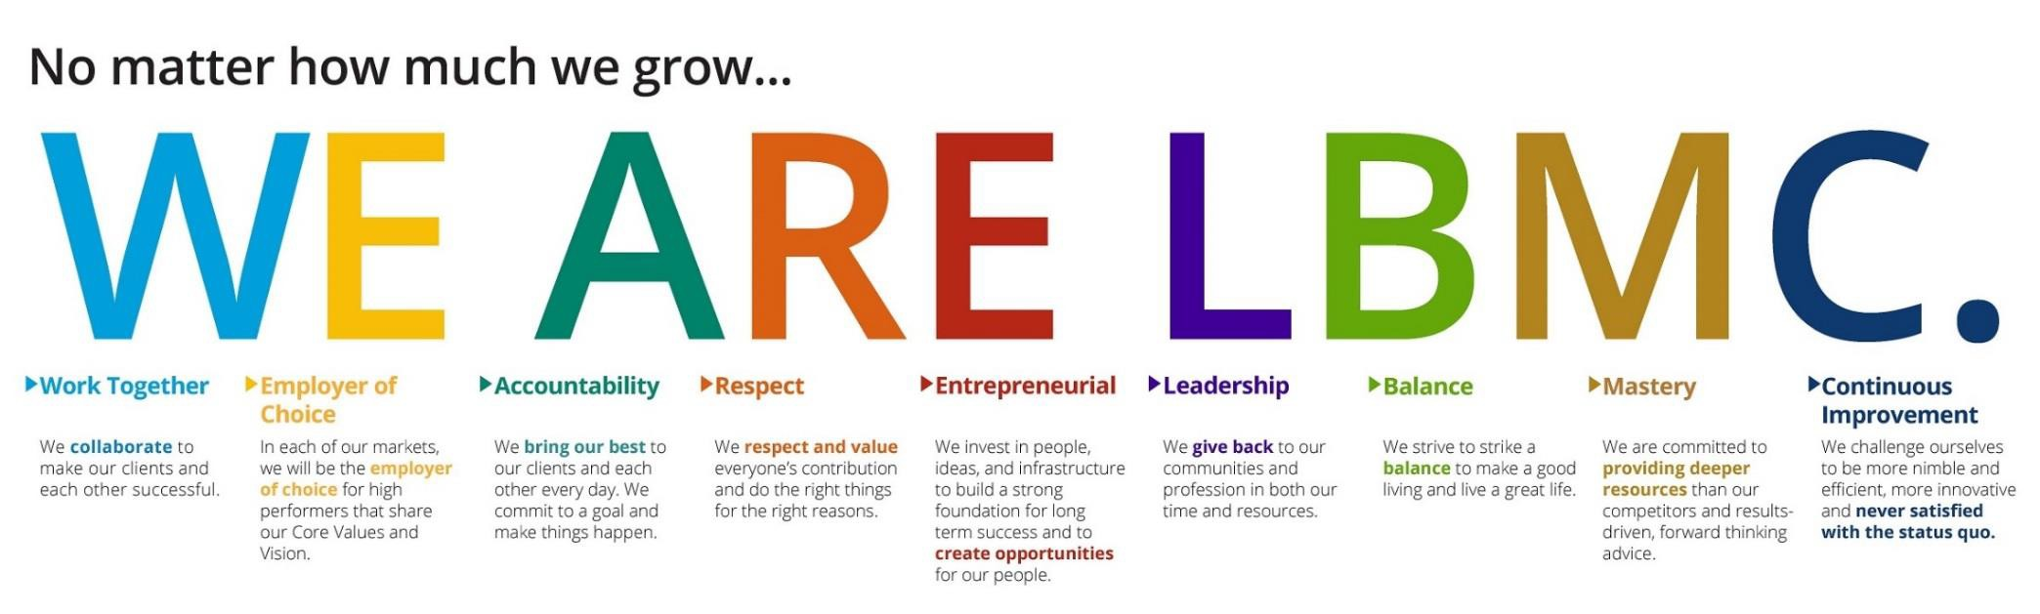
Our Values
Our core purpose is to make a
good business better.
Our shared vision is to make LBMC
the best choice for clients and colleagues.

Slide 6








Assurance
Transaction Services
Tax
Litigation Valuation
LBMC, PC
Healthcare Consulting
Information Security
State and Local Tax
Family Office

Slide 7





LBMC Technology Solutions, LLC
LBMC Employment Partners, LLC
LBMC Information Security, LLC
LBMC Staffing Solutions, LLC
Financial Services, LLC
LBMC Info Sec App, LLC
LBMC Physician Business Solutions , LLC
LBMC Investment Advisors, LLC
LBMC
W Squared, LLC
LBMC Procurement, LLC

Slide 8




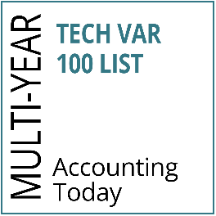


LBMC Technology Solutions LLC
BUSINESS & SOFTWARE
CONSULTING
Financial Software
(Intacct, Microsoft Dynamics 365, GP and SL)
Customer Relationship Management (CRM) software
(Microsoft Dynamics CRM, Salesforce) Enterprise Content Management
Software
(OnBase, Square 9, Box)
Office Automation Software (Office 365)
CLOUD COMPUTING & MANAGED SERVICES
On-Premise and Cloud Infrastructure Setup and Support (Amazon and Microsoft)
Remote Managed Services and Backup Solutions (TechCare)
Infrastructure as a Service Phone Systems (Digium)
Security Solutions
Outsourced CIO-level Services
SOFTWARE DEVELOPMENT
& BUSINESS INTELLIGENCE
Customized Software Development to include Mobile and Web Development
Business Intelligence (Power BI) & Data Warehousing
Microsoft SharePoint Services
Custom Integrations between line of Business Applications
Implementation and Support of Microsoft SQL Server and SQL Reporting Services
◆
◆
◆
◆
◆
◆
◆
◆
◆
◆
◆
◆
◆
◆
◆

Slide 9









LBMC Employment Partners LLC
THE LBMC DIFFERENCE
SERVICES
TRUSTED PARTNER
◆
Dedicated Human Resources Account Manager
Experienced and Knowledgeable Staff Strong Partnerships with BCBST and
Lincoln Financial Group
Partnership with Healthcare 21 Business Coalition (HC21)
Benefit Advocacy Services Health & Wellness Initiatives
Partnership with Zurich for Workers’
Compensation Insurance
Market Leader in the Professional
Service Industry
Recognized as a Member of the National Association of Professional Employer Organizations (NAPEO)
Innovative and Efficient User of Progressive Technology
◆
Certified Professional Employer Organization (CPEO)
Human Resources Outsourcing (HRO) Payroll Tax Outsourcing and Consulting Employee Benefits
Payroll Services
Human Resource Consulting
ACA Compliance Consulting and Tracking Services
◆
Our employees keep us on the road, and that makes them our greatest asset. We made a great business decision when we decided to hire LBMC Employment Partners to help us take care of those who take care of our customers.”
◆
◆
◆
◆
◆
◆
◆
◆
◆
◆
◆
– President & CEO, Distribution Service Company
◆
◆
◆
First CPEO certified provider in Tennessee

Slide 10



LBMC Staffing Solutions LLC
THE LBMC DIFFERENCE
CONTRACT PLACEMENT AND DIRECT HIRE POSITIONS
TRUSTED PARTNER
◆
Professional Recruiters with Expertise in
the Specific Disciplines for Which They Recruit
Expansive Candidate Referral Network through Affiliation with One of the Southeast’s Premier Financial Services Firms
Enhanced Employee Retention with Pre- Screened Candidates for Technical and Cultural Fit
Consultative Approach Supported by Market Knowledge and Industry Experience
Efficient Qualification, Selection and Presentation of Candidates
Accounting & Finance
Human Resources
Information Technology
Executive Administration
Key Specialized Manufacturing Roles
◆
◆
They are committed to excellence, and finding a “perfect fit” for our position that will be with us for years to come. The strong skills the LBMC team brings to the table make them outstanding at partnering with us to select individuals at all levels to join our team.”
–PHR Director of Human Resources, Healthcare Management Solutions Provider
◆
◆
◆
◆
◆
◆
◆

Slide 11

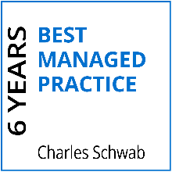



LBMC Investment Advisors LLC
INVESTMENT & ADVISORY SERVICES
Customized Investment Portfolios
Index ETFs and Individual Bonds
LBMC IA App
Coordinated Tax and Investment Advice

Slide 12


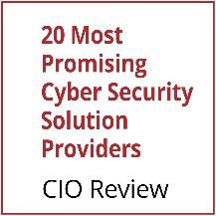

LBMC Information Security LLC
MANAGED SECURITY SERVICES
LBMC will minimize threats and respond with:
◆
Intrusion Prevention and Detection Services Security Information and Event Management Incident Response and Forensics Vulnerability and Threat Management
◆
◆
◆

Slide 13


LBMC W Squared LLC
Outsourced Finance
Outsourced Services
Our people, our processes and our infrastructure are ready to scale with you.
Strategic & Financial Management Services
CFO-level expertise & strategy
Comprehensive financial analysis (budgeting, forecasting & pro forma)
Preparation & process for future monetization event
Relationship management with private equity/venture capital partners
Investor pitch development
Capital funding strategy
Accounting Services
Comprehensive financial statement reporting (Analysis, KPIs, Board Package)
Month-end close & general ledger management
Accounts payable/receivable processing
Cash management
Electronic payments capability
Multi-entity consolidation & segment reporting
Tax & audit package preparation

Slide 14
LBMC Procurement Solutions LLC
PROCUREMENT SERVICES
Purchase like an enterprise.
Aggregating at SKU Level
Deeply Rooted Supply Base Relationships
Quarterly Business Review (QBR) Process for Suppliers
Client Partner Reporting
Negotiated Pricing with Extensive Supplier Network
Medical and Surgical Supplies and Equipment
National Lab Testing
Office Supplies
Lab Consumables
Small Package Shipping
Travel
Printed and Promotional Products
IT Software/Hardware
Office Renovations

Slide 15




LBMC Physician Business Solutions LLC
PHYSICIAN PRACTICE REVENUE CYCLE SOLUTIONS
PHYSICIAN MANAGEMENT SUPPORT & EMR SOLUTIONS
PHYSICIAN PRACTICE MANAGEMENT/ ADMINISTRATIVE OVERSIGHT
MEDICAL SERVICES ORGANIZATION (MSO)
Expert financial management
Everything you need to conquer billing, collections, claims processing
Efficient, cost-effective oversight with an eye to your bottom line
Comprehensive solution tailored to specific physician- related needs
◆ IT Solution Featuring Electronic Medical Records
◆ Revenue Cycle Staffing
◆ Claims Processing
◆ Accounts Receivable Management
◆ Patient Billing
◆ Payment Processing
◆ Monthly A/R Closeout Reporting
◆ Certified Coding Oversight
Electronic Medical Records
(EMR) Vendor Review
EMR Selection, Implementation and Management
IT Solutions
PMR-EMR-HER
Selection of PM/EMR Solution
Request for Proposal Development
Vendor Evaluation
Contract Negotiation
Implementation of PM/EMR, including:
Management Support
Regular Onsite Visits
Workflow Processes Management
Software Interface Management
Data Migration Supervision
Template Creation
Go LIVE Support
Administrative Oversight- Administrative Consulting Services to Support Practice Leaders
Financial and Operational Consulting
Human Resources Services
Coding, Billing, Corporate Compliance including ICD-10 Implementation and Training
MACRA/MIPS
Physician Practice Billing/Collection Services
Benefits and Human Resources Services (HRO/PEO)
Physician Practice Management and Administrative Oversight
Coding/Compliance Services
Practice Management Consulting, as needed
Outsourced Accounting
GPO

Slide 16

BALLAST
BALLAST
Automating and Empowering Risk Management
Reducing Assessment Fatigue
Software as a Service
Subscription-based
Automated Assessments for:
Cyber Risk
Compliance
Vendor Risk
Operational Controls
Client Defined/Custom
Dashboard Reporting
Remediation Management and Tracking
Repository for Assessment Evidence
Versions available for
End-user organizations
3rd Party Assessors & Consultants

Slide 17
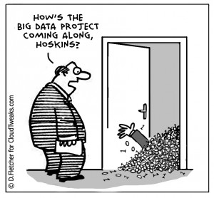
Value of a Data Warehouse
Data can be stored and used in many forms in a business
Application Databases
Excel workbooks
3rd Party API
Flat Files
Would like to analyze data across all these sources
Data can be loaded into a centralized data warehouse for analysis

Slide 18
DW Solution Architecture

Slide 19
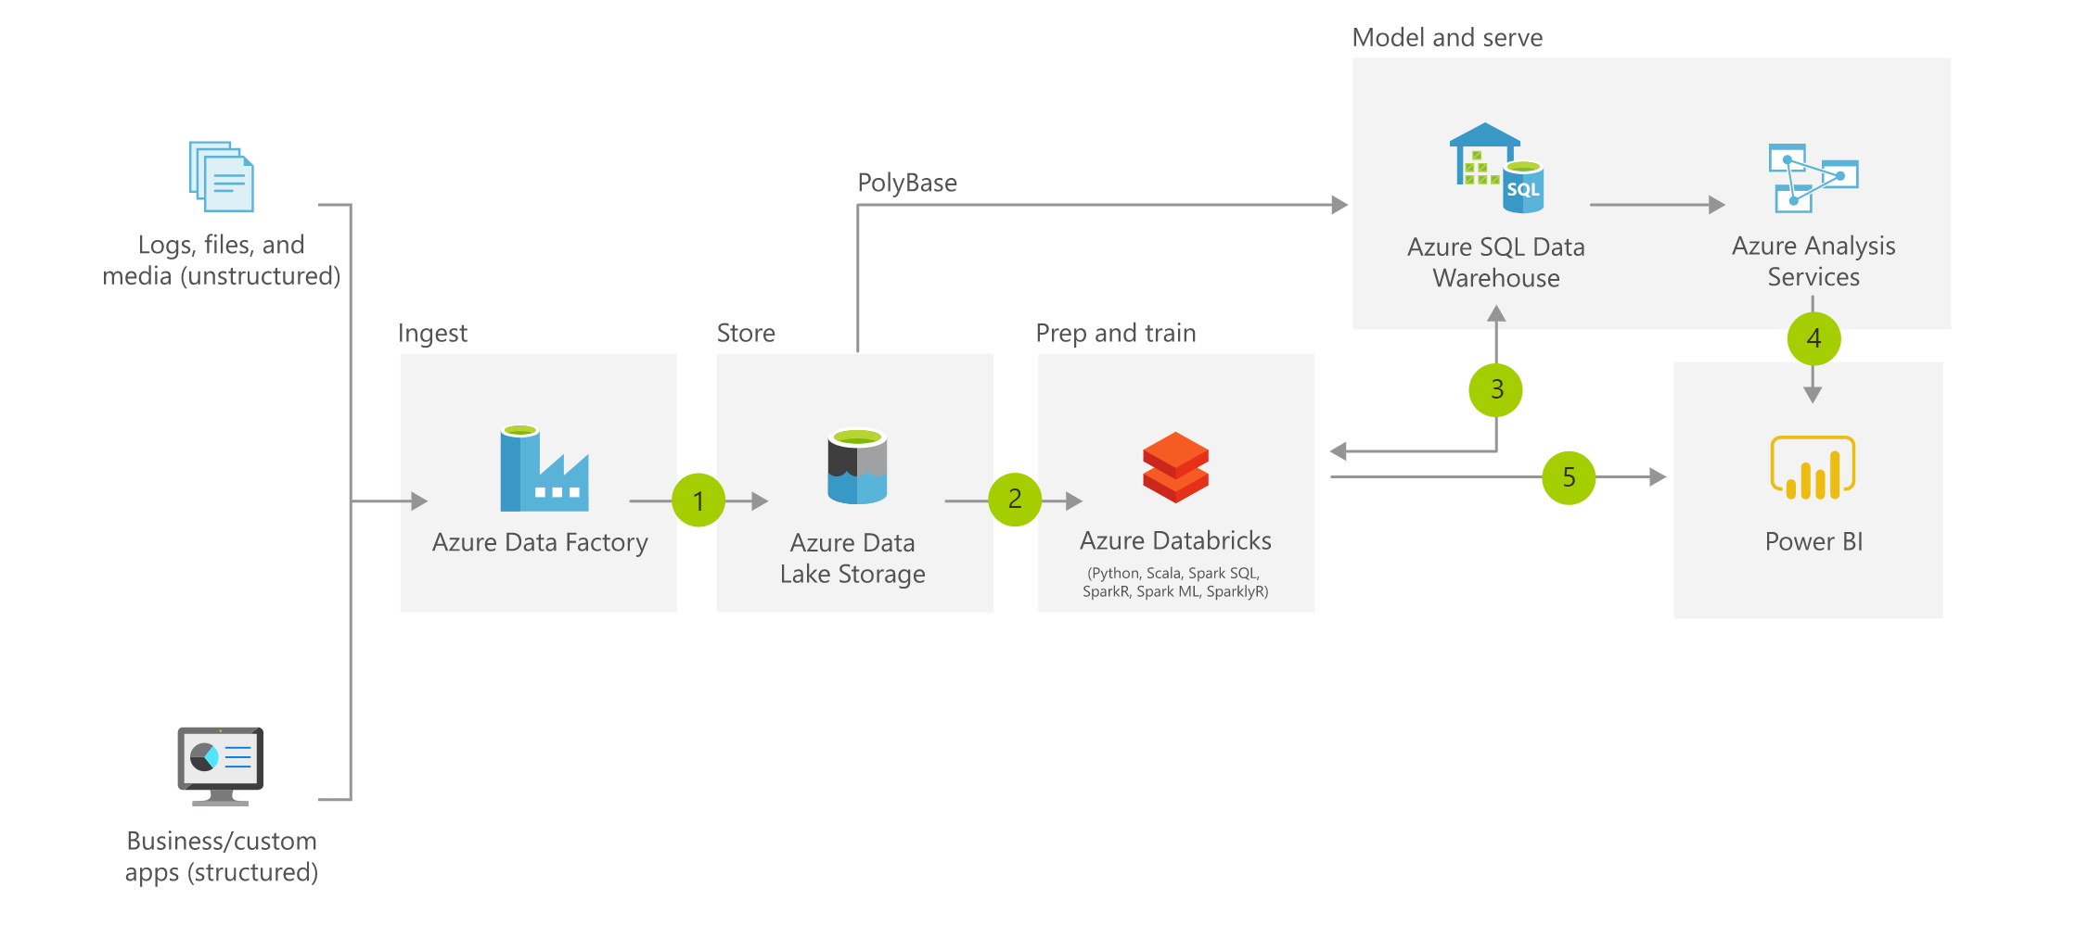

Slide 20
OLTP vs OLAP
Application systems are typically optimized for dealing with a few rows of data at a time
On-Line Transactional Processing (OLTP)
Usually working with a single record at a time
Processing a sales transaction, looking up a sales record for a return
This is inefficient for analytical processing
Working with thousands to millions of records at a time
On-Line Analytical Processing (OLAP)
Viewing Total Sales Orders by Sales Territory for FY 2016

Slide 21
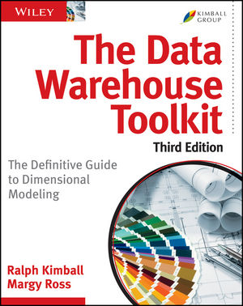
The Dimensional Model
Popularized by Ralph Kimball (The Data Warehouse Toolkit)
ETL Processes data from source systems into a dimensional model
The ETL will be about 70% of a DW Project
Dimensional Models contain two types of tables
Dimension Tables
Nouns of the business – Describe the business process
Examples: Date, Customer, Product, Store, Geography, Employee
Fact Tables
Verbs of the business – Measure the business process
Examples: Sales, Patient Visit, Inventory, Attendance, Claims
Gives us Scalability, Performance, and Simplicity

Slide 22
But don’t take my word for it
“In general, a star schema following Kimball modeling techniques is the optimal data model to build into a Tabular model. “
Performance Tuning of Tabular Models in SSAS 2012
https://docs.microsoft.com/en-us/previous-versions/sql/sql-server-2012/dn393915(v=msdn.10)
This will also apply to PowerBI modeling

Slide 23
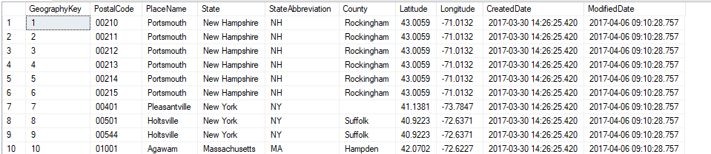
Dimension Tables
Holds descriptive characteristics of a business process
De-normalized tables allows for simple queries
Dimension tables are small compared to fact tables
Surrogate Key generated for each row and used in fact table
Allows for single column joins using integers

Slide 24
Slowly Changing Dimensions
Type I
Update the record, historical data no persevered
Type II
Add a new row, historical data persevered
Type III
Add a new column, allows for comparative analysis
Type VI
Combination of techniques in types 1,2 and 3 (1+2+3 = 6)

Slide 25
Other Dimension Methods
Other Types of Dimensions
Mini-Dimension
Subset of data to reduce table size of a large dimension
Junk Dimension
Low cardinality elements combined into a single dimension
Degenerate Dimension
High cardinality elements left on fact table
Role-Playing Dimension
A dimension used many times in single business process

Slide 26
Multi-Valued Dimensions
What do you do when a single dimension could have multiple values?
Multiple Diagnosis Codes
Discounts or Promotions applied to a sale
Tags on a work item
Bridge tables group multiple dimensions into a single key
Fact table references the single key

Slide 27
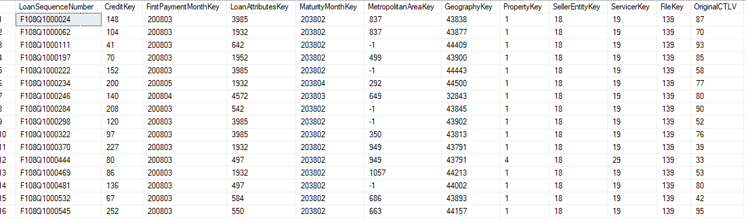
Fact Tables
Largest tables in the warehouse
Columns are surrogate keys to dimensions and measurement values
Typically will have millions of rows, in some cases billions
Defined by the Grain
The grain indicates what an individual row represents in a fact table
“One row per line item in a sales transaction”

Slide 28
Type of Fact Tables
Multiple ways to measure and store business events
Some of these are used together to create a complete picture
Transactional Fact Table
Records events as they occur
Data is typically not revisited
Periodic Snapshot Fact Table
Events are measured on intervals
Data is not revisited, new snapshots are inserted into the table
Accumulating Snapshot Fact Table
Used for tables with defined beginning, intermediate, and end milestones
Data is revisited and updated with new information

Slide 29
ColumnStore Indexing
Data traditionally stored row by row
Think of it like (but not really) a CSV
The entire row is read from disk every time
ColumnStore stores data column-wise
Columns are stored separately
Rows are “reconstructed” at query time
Large gains in compression and performance
Super fast for aggregate queries!

Slide 30
Star Schema

Slide 31
Kimball Design Process
1. Identify the Business Process
2. Declare the Grain
3. Identify Dimensions
4. Identify Measures

Slide 32
TL;DR;
Source data systems are inadequate for proper analytics
Can’t combine with other sources
May interrupt operational activities
Organize data into Dimensions and Facts
Dimension table describe attributes of the business
Fact tables measure business processes and events
This provides a scalable and extendable model for your data
Start with the Business Process
Top down approach
Identify the key elements of the model first and iterate

